Slide 1


Slide 2
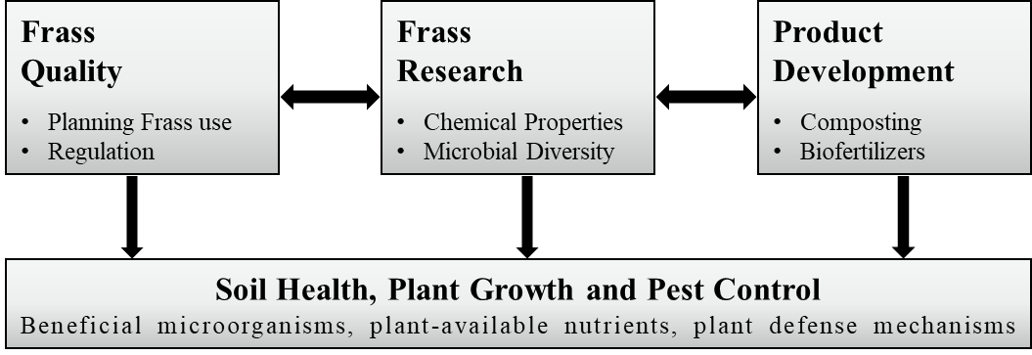
Frass
Quality
Planning Frass use
Regulation
Frass
Research
Chemical Properties
Microbial Diversity
Product Development
Composting
Biofertilizers
Soil Health, Plant Growth and Pest Control
Beneficial microorganisms, plant-available nutrients, plant defense mechanisms
there are a number of reasons why information on the frass type, effect on plants and herbivore performance is required including, planning frass management and regulation, frass research and product development. These applications all have an implications for soil health, plant growth promotion and yield lifting, and the control of herbivore pest, which form the basis for directing frass use into more efficient and environmentally applications and fulfilling nutrient recycling in a circular agriculture.
See example of figure above: https://doi.org/10.1038/sj.ejcn.1602937

Slide 3
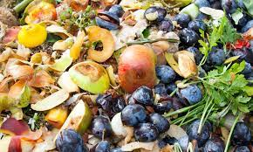
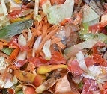
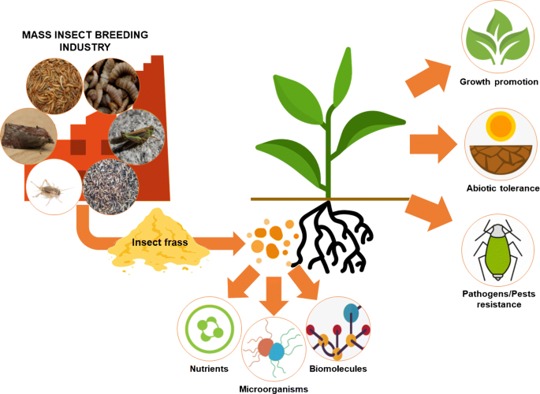
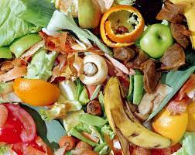
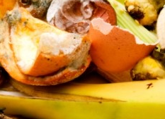
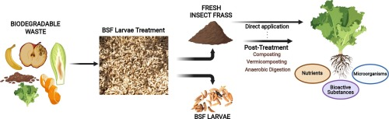
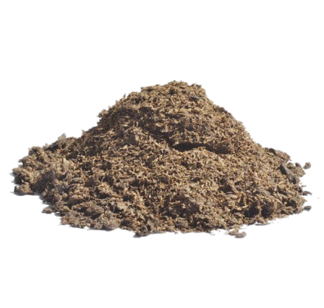

Slide 4
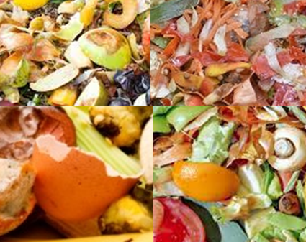

Slide 5
GLM: Χ² = 0.92; p = 0.6314
B
A
b
a
ab
32/40
62/65
50/57
n = 7
n = 7
n = 7
Figure 7_trial 1. Fly emergence, Delia radicum, ATP

Slide 6
Chi-squared test of proportions: Χ² = 0.24; p = 0.8869
GLM: Χ² = 0.11; p = 0.9468
A
B
22/29
41/51
35/45
n = 9
n = 10
n = 11
Figure S6_trial 2. Fly emergence, Delia radicum, ATP

Slide 7
A: Fly emergence, trial 1
B: Fly emergence, trial 2
Chi-squared test: Χ² = 0.24; p = 0.8869
b
a
ab
22/29
41/51
35/45
32/40
62/65
50/57
C: Time until fly emergence, trial 1
D: Time until fly emergence, Trial 2
GLM: Χ² = 0.92; p = 0.6314
GLM: Χ ² = 0.11; p = 0.9468
n = 9
n = 10
n = 11
n = 7
n = 7
n = 7
n = 9
n = 10
n = 11
Figure S6: A = fly emergence - trial 1, B = fly emergence - trial 2, C = time until emergence –trial 1, D = time until emergence –trial2; Delia radicum, ATP

Slide 8
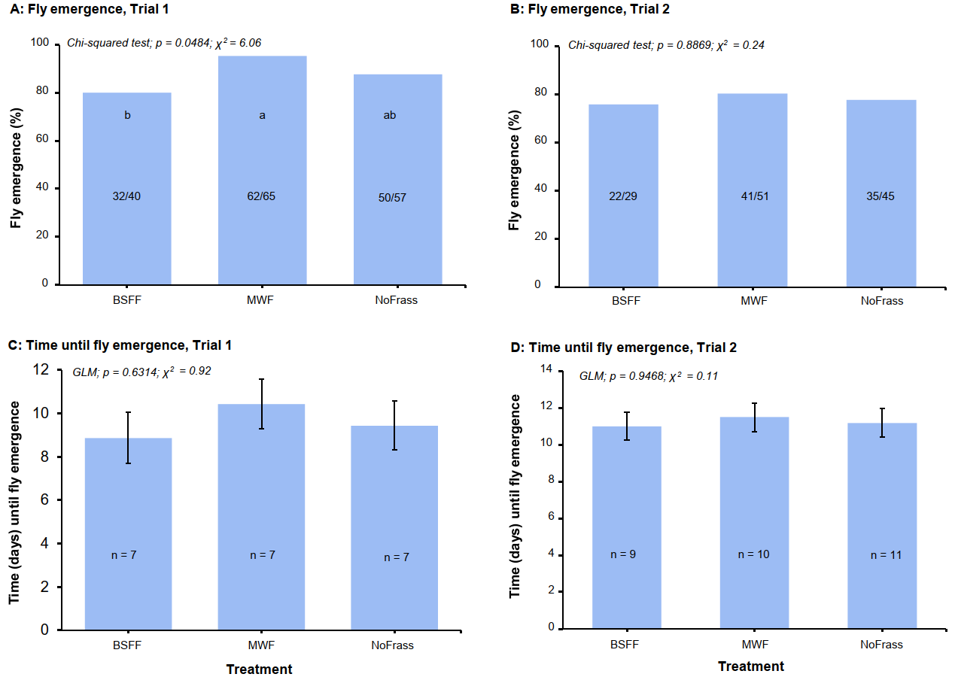
Notes:
Final Figure S7

Slide 9
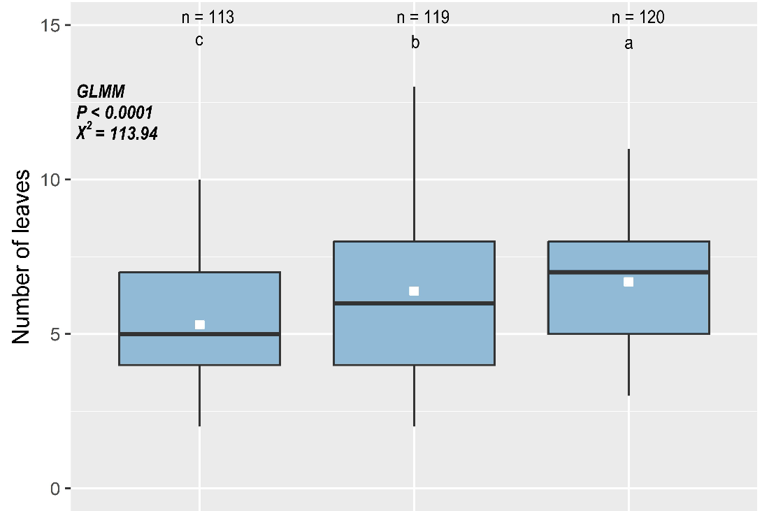
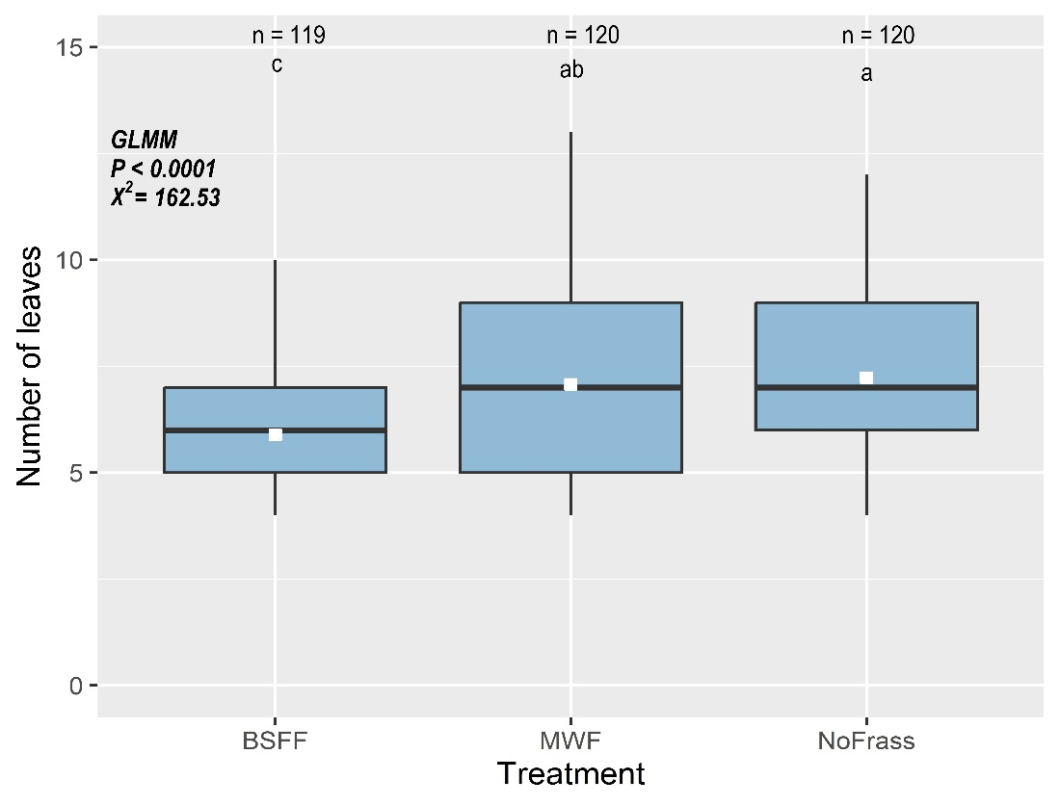
raw frass
A
B
Notes:
A = raw frass, trial 1; B = raw frass, trial 2

Slide 10
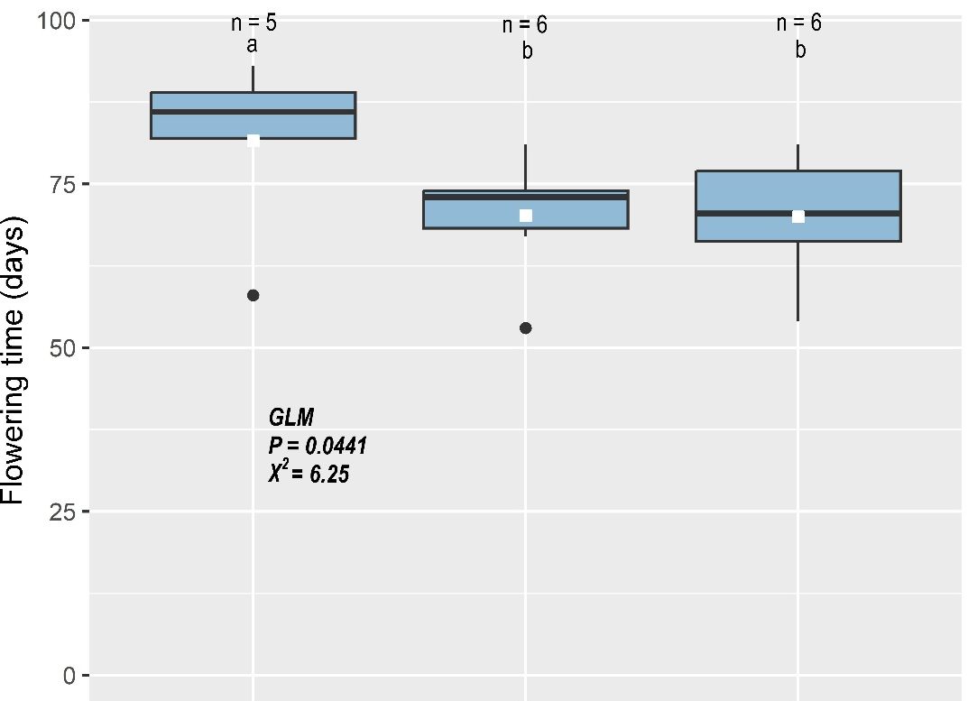
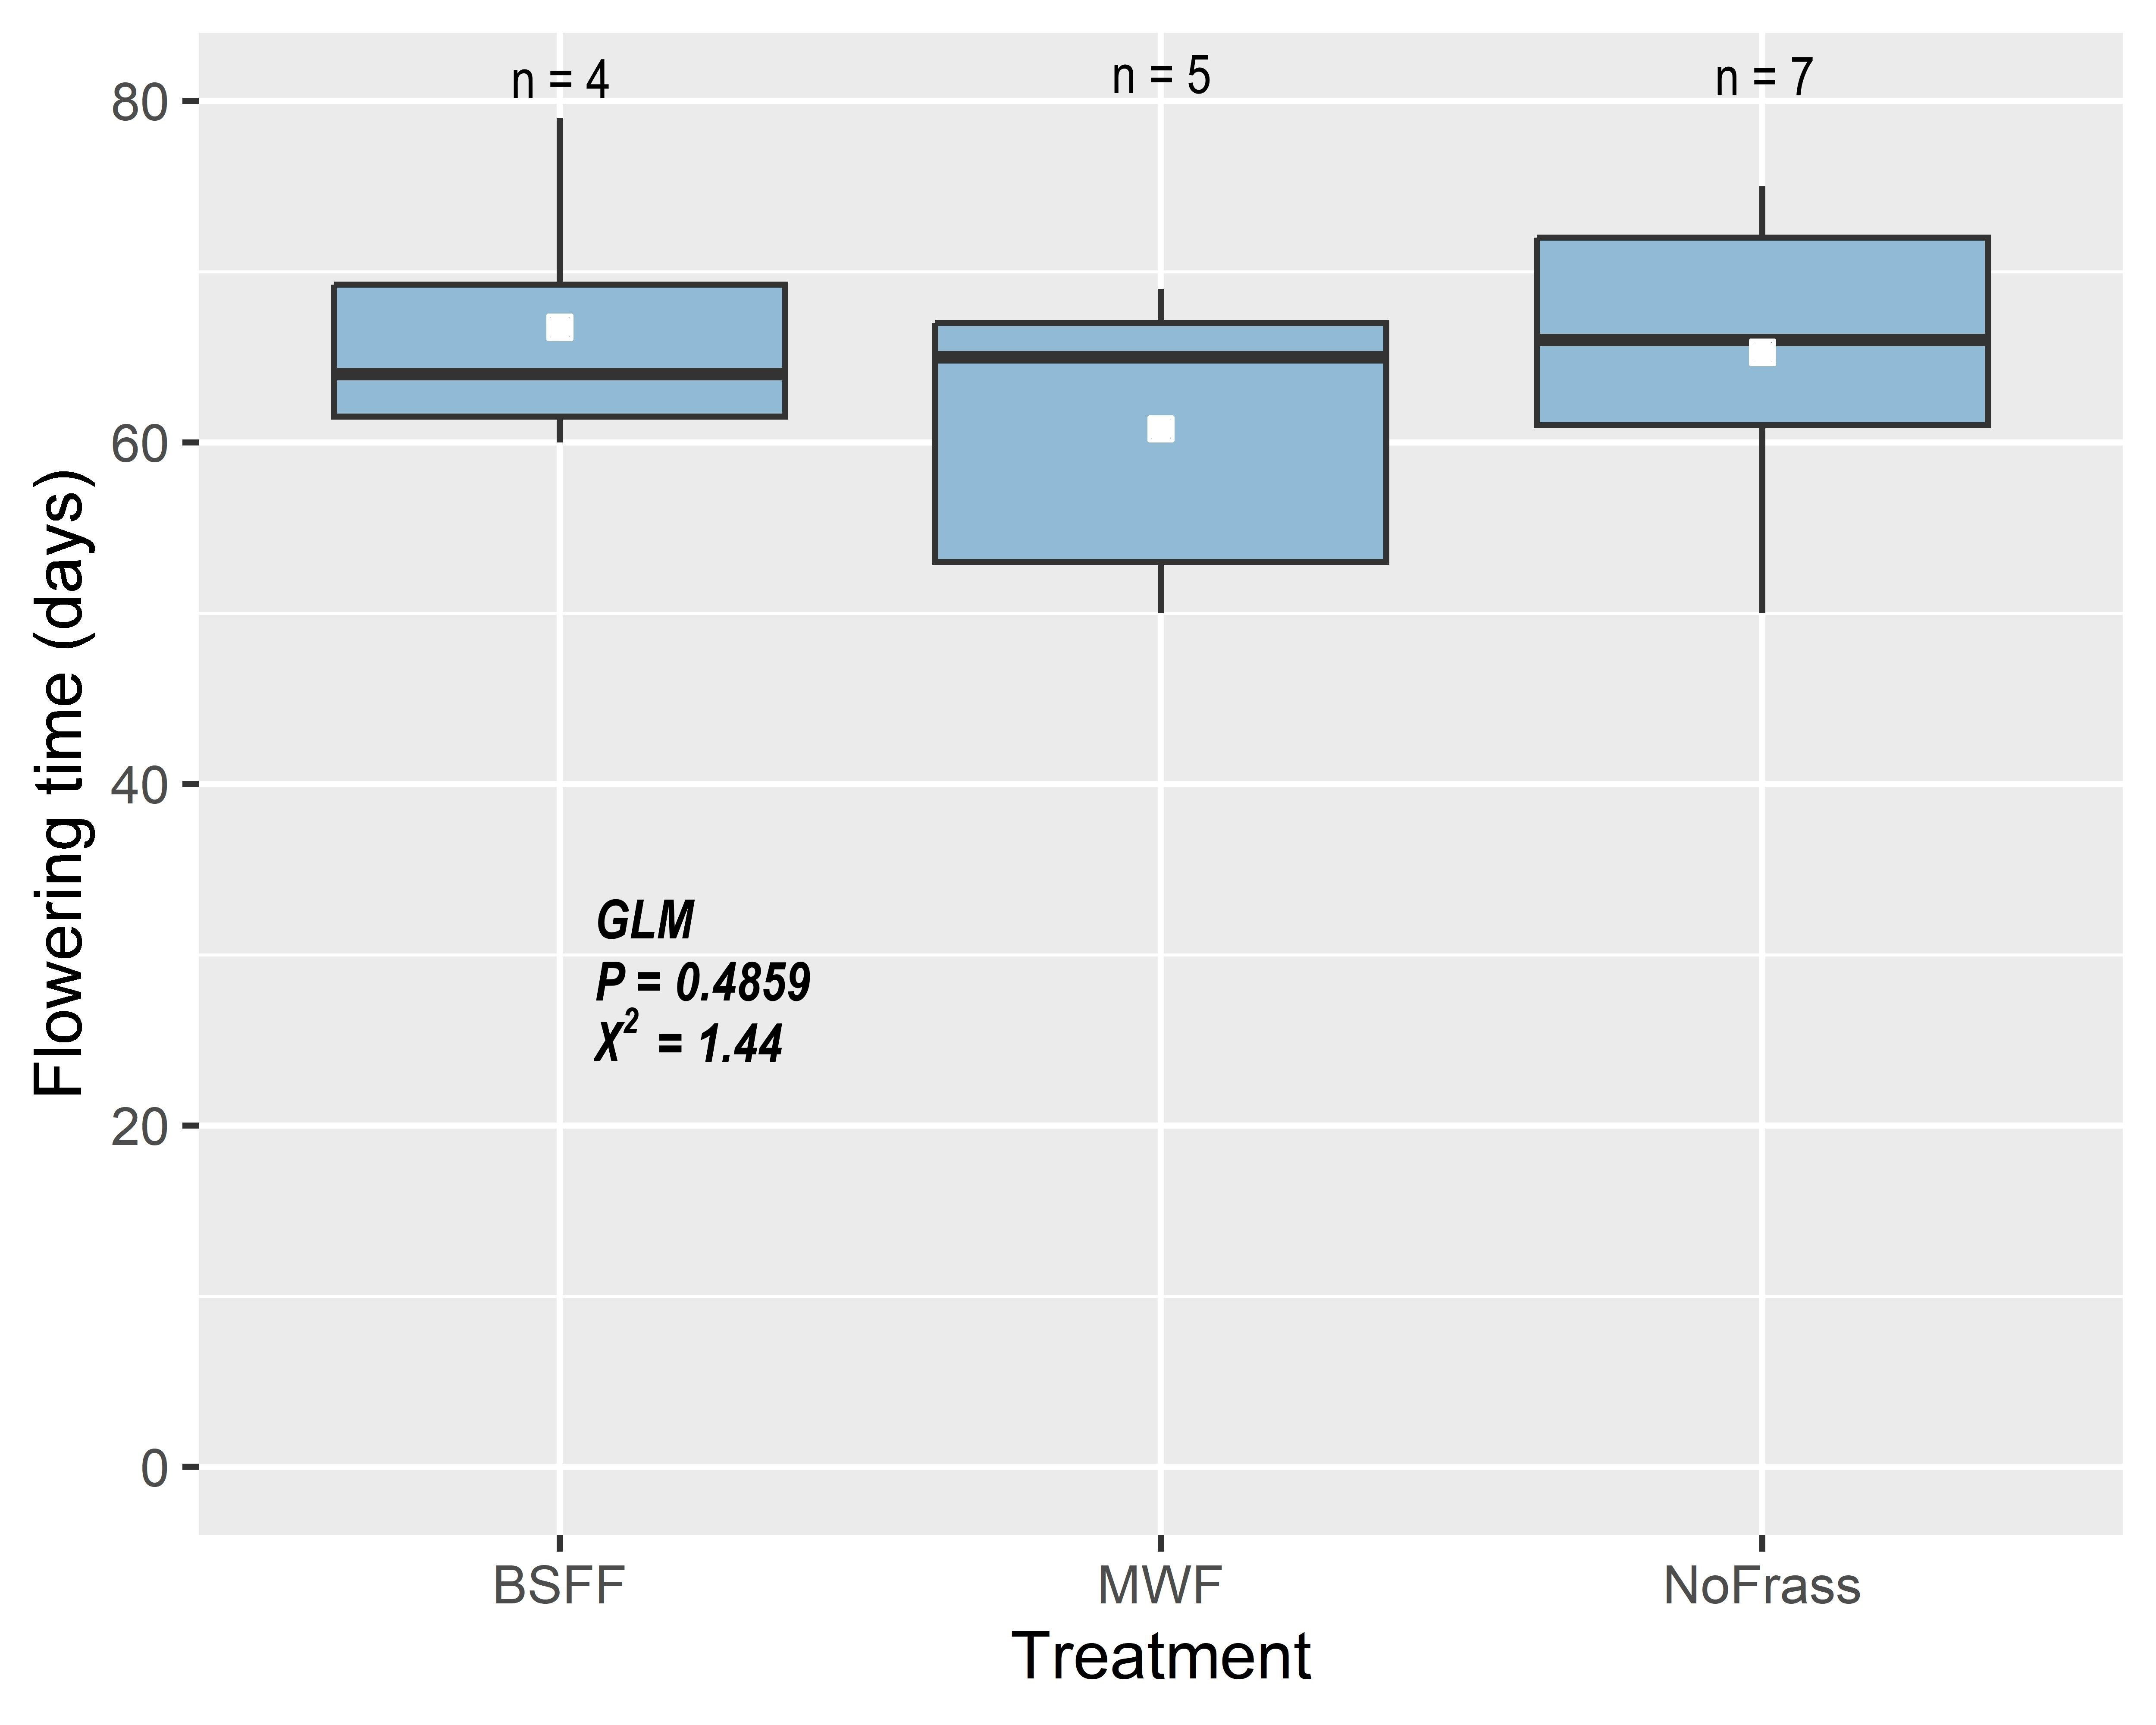
Raw frass
A
B
Notes:
Raw frass, A = trial 1; B = trial 2

Slide 11
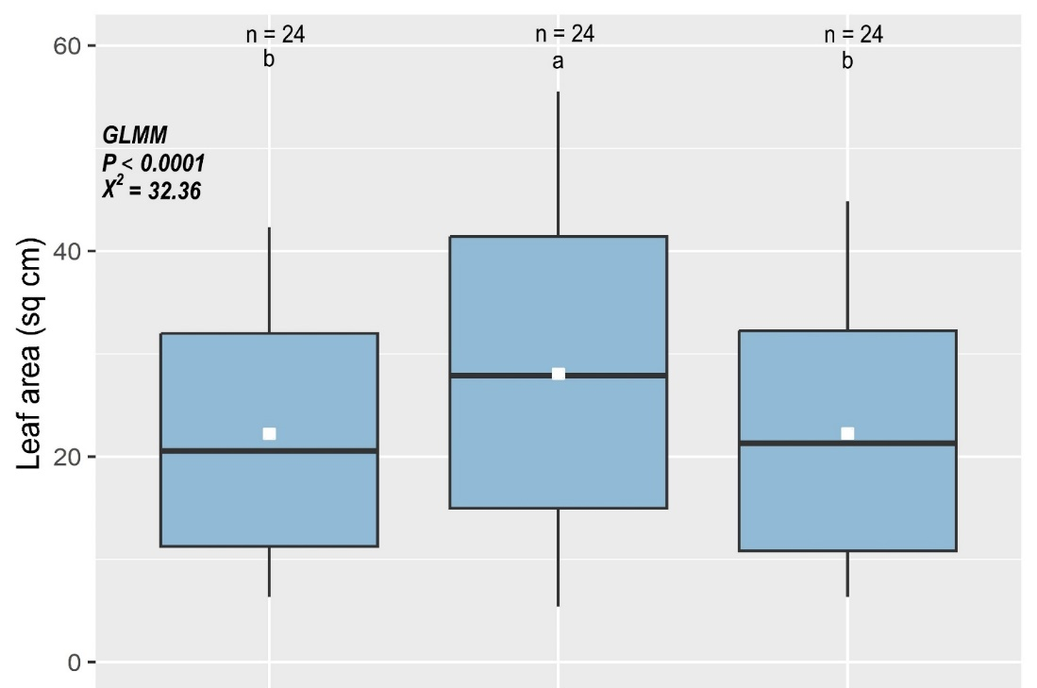
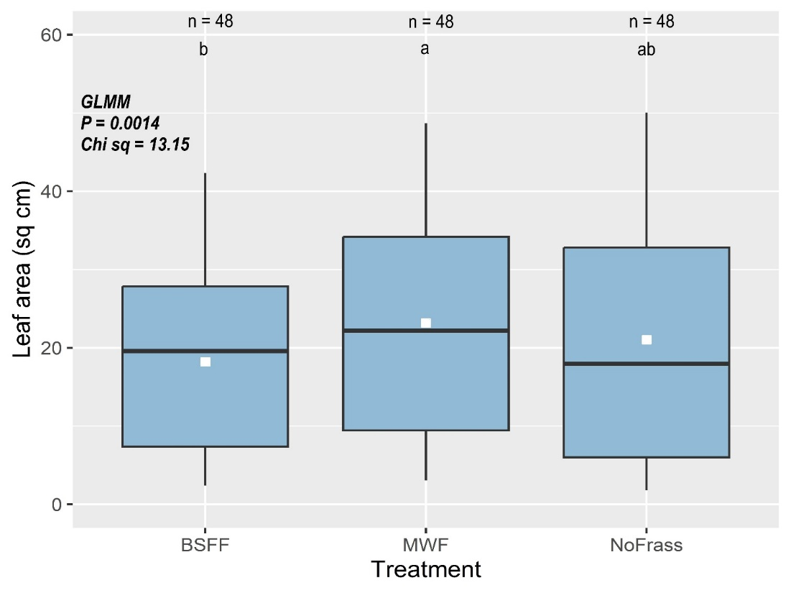
Processed frass
A
B
Notes:
A = incubated frass; B = Composted frass

Slide 12
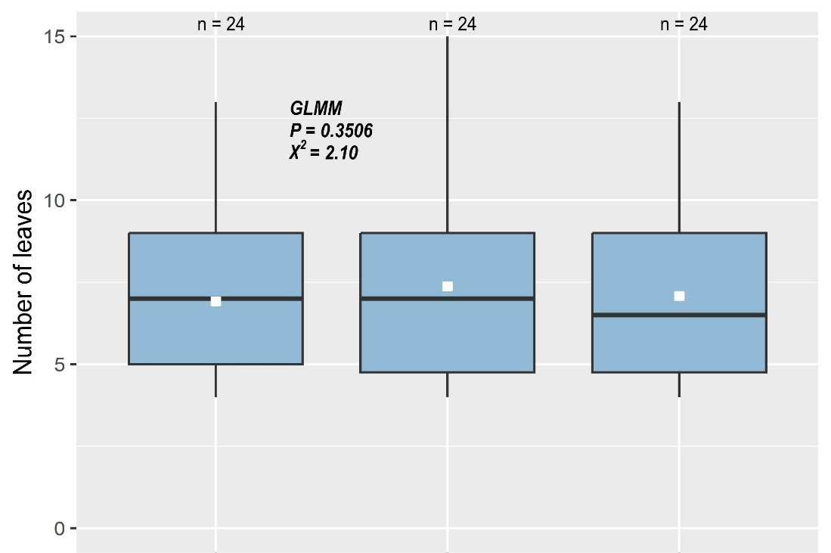
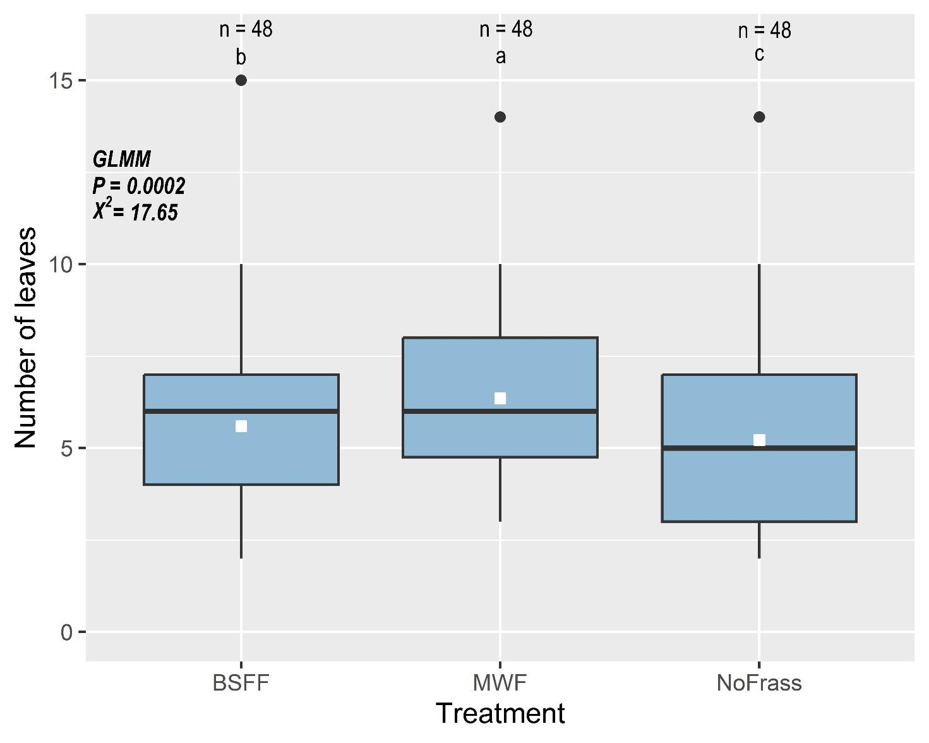
A
B
Notes:
A = incubated frass; B = Composted frass

Slide 13
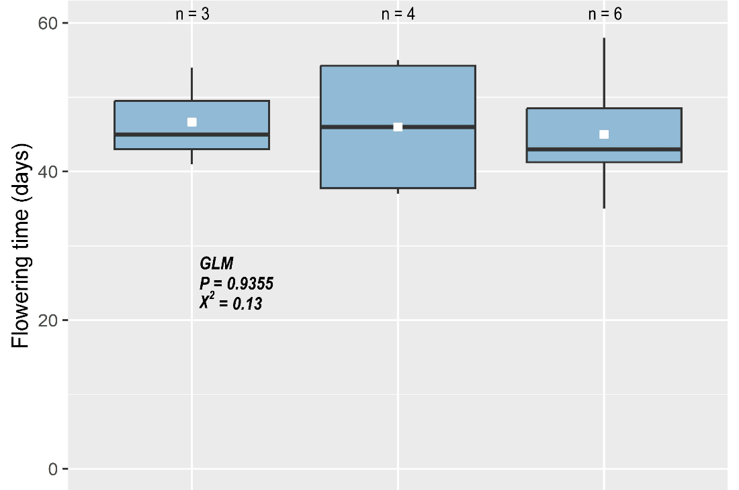
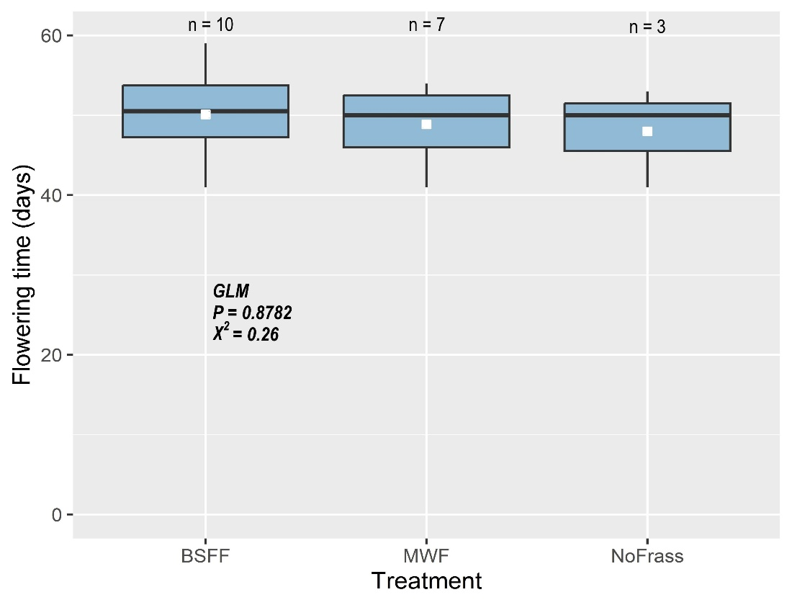
Processed frass
A
B
Notes:
Processed frass: A = Incubated frass; B = Composted frass

Slide 14
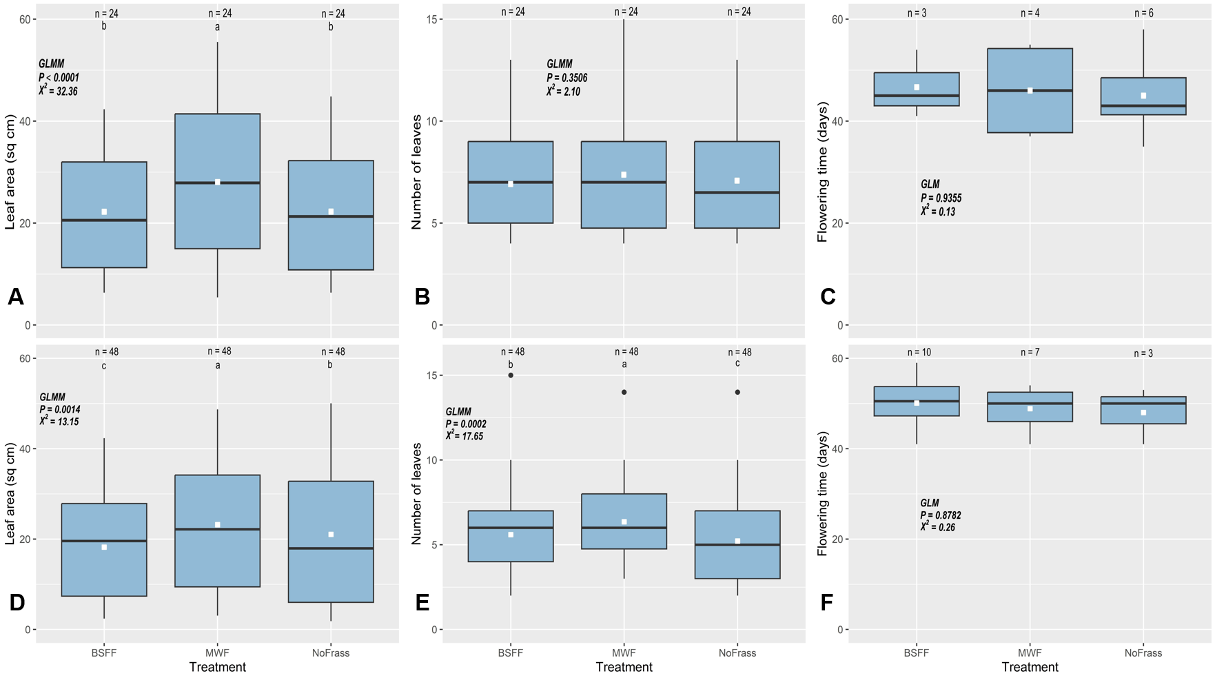

Slide 15
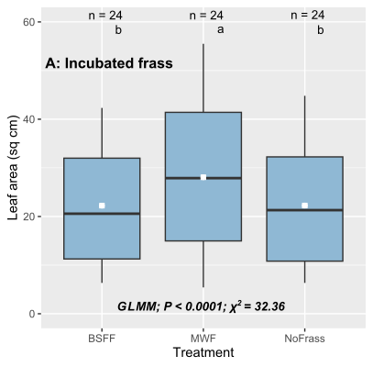
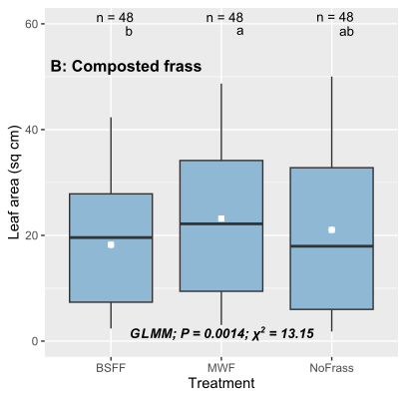
Notes:
Latest figures, processed frass, Figure S1

Slide 16
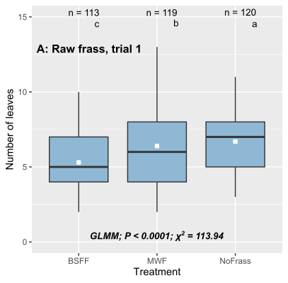
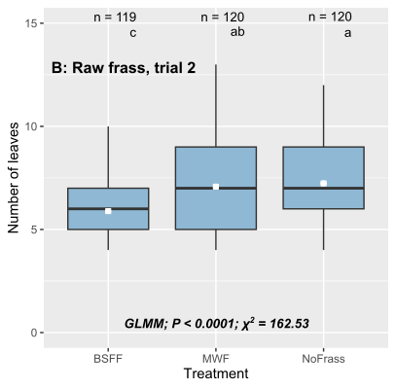
Notes:
Number of leaves, raw frass, Figure S2

Slide 17
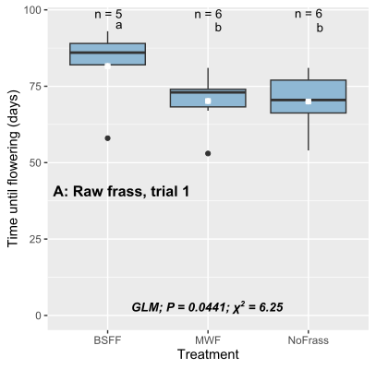
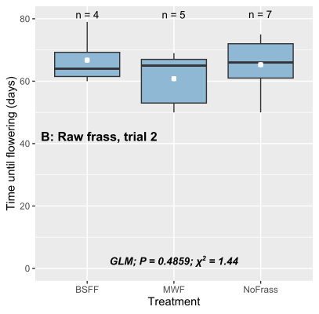
Notes:
Time until first flower emergence, raw frass

Slide 18
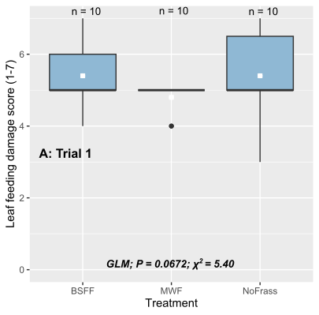
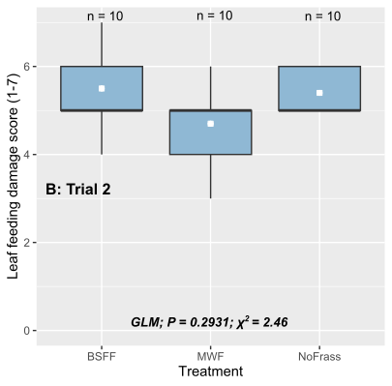
Notes:
Figure S8; Leaf damage, trials 1 & 2

Slide 19
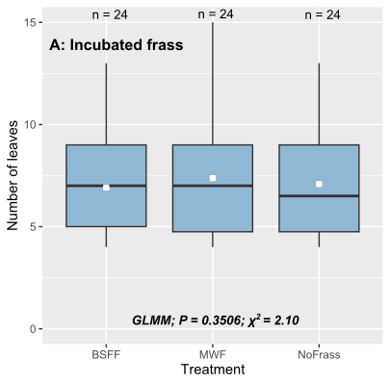
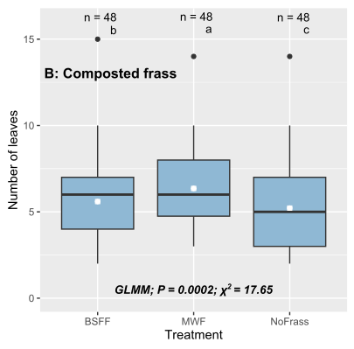
Notes:
Figure S9.

Slide 20
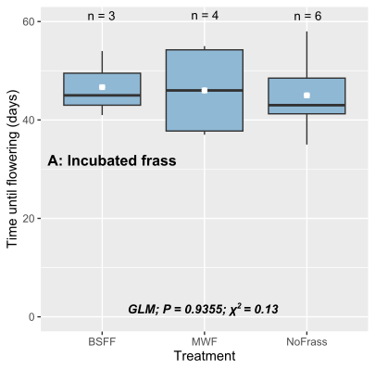
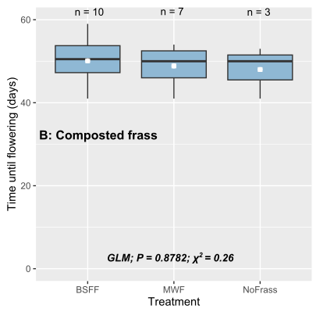
Notes:
Figure S10

